Slide 1
Deadlocks
Chapter 3
3.1. Resource
3.2. Introduction to deadlocks
3.3. The ostrich algorithm
3.4. Deadlock detection and recovery
3.5. Deadlock avoidance
3.6. Deadlock prevention
3.7. Other issues

Slide 2
Resources
Computer systems are full of resources.
Examples of computer resources
  printers
  tape drives
  tables
Processes need access to resources in reasonable order
Suppose a process holds resource A and requests resource B
  at same time another process holds B and requests A
  both are blocked and remain so

Slide 3
Resources (1)
Deadlocks occur when …
  processes are granted exclusive access to devices
  we refer to these devices generally as resources
Preemptable resources
  can be taken away from a process with no ill effects
Nonpreemptable resources
  will cause the process to fail if taken away

Slide 4
Resources (2)
Sequence of events required to use a resource
  request the resource
  use the resource
  release the resource
Must wait if request is denied
  requesting process may be blocked
  may fail with error code

Slide 5
Introduction to Deadlocks
Formal definition :
A set of processes is deadlocked if each process in the set is waiting for an event that only another process in the set can cause
Usually the event is release of a currently held resource
None of the processes can …
  run
  release resources
  be awakened

Slide 6
Four Conditions for Deadlock
Mutual exclusion condition
  each resource assigned to 1 process or is available
Hold and wait condition
  process holding resources can request additional
No preemption condition
  previously granted resources cannot forcibly taken away
Circular wait condition
  must be a circular chain of 2 or more processes
  each is waiting for resource held by next member of the chain

Slide 7
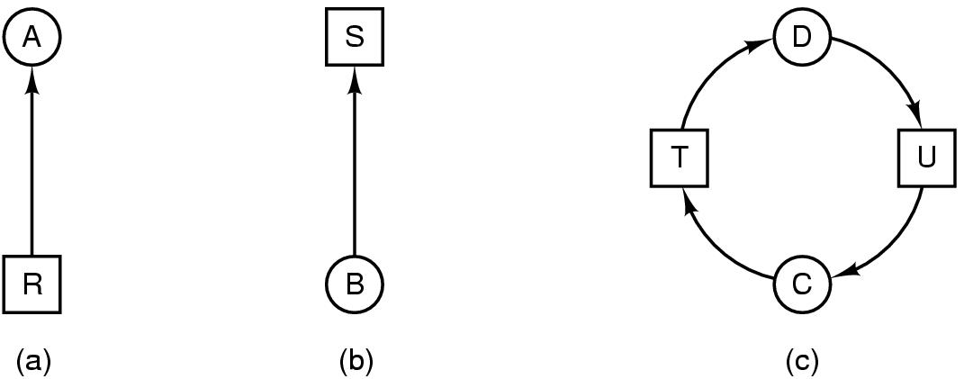
Deadlock Modeling (2)
Modeled with directed graphs
  The graphs has two kinds of nodes: processes shown as circles, and resources shown as squares
  resource R assigned to process A
  process B is requesting/waiting for resource S
  process C and D are in deadlock over resources T and U

Slide 8
Deadlock Modeling (3)
Strategies for dealing with Deadlocks
  just ignore the problem altogether
  detection and recovery
  dynamic avoidance
    careful resource allocation
  prevention
    negating one of the four necessary conditions

Slide 9
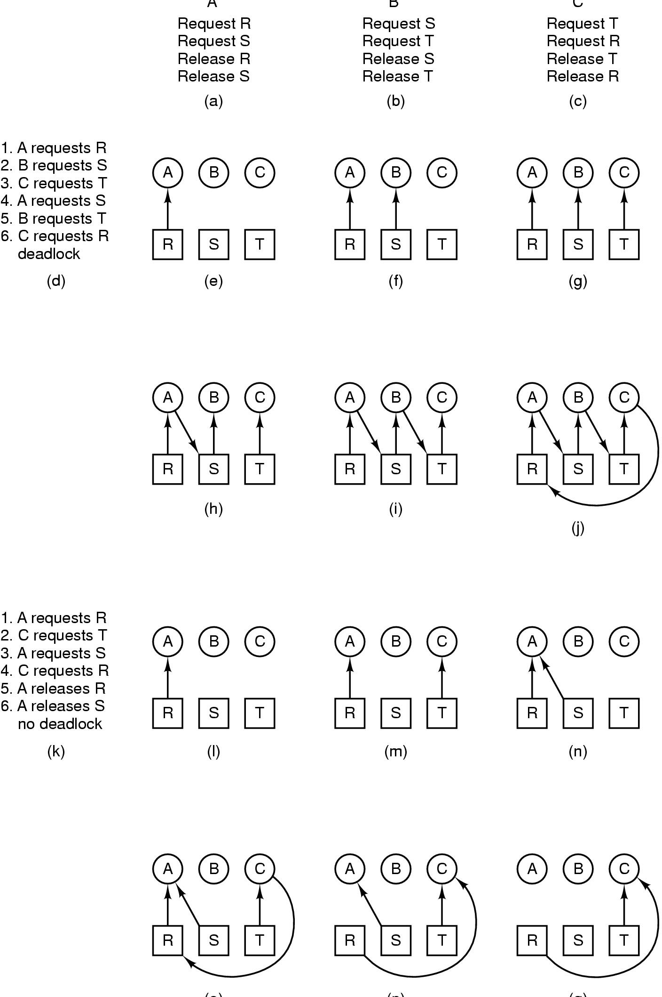
Deadlock Modeling (4)
A B C
How deadlock occurs

Slide 10
Deadlock Modeling (5)
(o) (p) (q)
How deadlock can be avoided

Slide 11
The Ostrich Algorithm
This is used when the time intervals between occurrences of deadlocks are large and the data loss incurred each time is tolerable.
Pretend there is no problem
Reasonable if
  deadlocks occur very rarely
  cost of prevention is high
UNIX and Windows takes this approach
It is a trade off between
  convenience
  correctness

Slide 12

Detection with One Resource of Each Type (1)
Note the resource ownership and requests
A cycle can be found within the graph, denoting deadlock

Slide 13
Algorithm
The algorithm inspects a graph and terminates
  either when it has found a cycle
  or when it has shown that none exist
It uses a data structure, L a list of nodes
During the algorithm, arcs will be marked to indicate that they have already have been inspected, to prevent repeated inspections

Slide 14
Algorithm.. continue
The algorithm operates by carrying out the following steps:
  For each node, N in the graph, perform the following 5 steps with N as the starting node.
  Initialize L to the empty list and designate all arcs as unmarked.
  Add the current node to the end of L and check if the node now appears in L two times.
    If it does, the graph contains a cycle (listed in L) and algorithm terminates
  From the given node, see if there are any unmarked outgoing arcs. If so, got to step 5, if not go to step 6
  Pick an unmarked outgoing arc at random and mark it. Then follow it to the new current node and go to step 3.

Slide 15
Algorithm.. continue
We have now reached a dead end.
  Remove it and go back to the previous node (ie the one that was current just before this one, make that one current node and go to step 3)
  If this node is the initial node, the graph does not contain cycles and the algorithm terminates.
What this algorithm does is take each node, in turn, as the root of what it hopes will be a tree and does a depth-first search on it.
  If it ever comes back to a node it has already encountered, then it has found a cycle.
  If it exhausts all the arcs from any given node, it backtracks to the previous node.
  If it backtracks to the root and cannot go further, the subgraph reachable from the current node does not contain any cycles.
  If this property holds for all nodes, the entire graph is cycle free (no deadlock)

Slide 16
Detection with One Resource of Each Type (2)
When multiple copies of some of the resources exist, a different approach is needed.
A matrix-based algorithm is employed for detecting deadlock among n processes, P₁ through P_{n.}
Let the number of resource classes be m with
  E₁ resources of class 1
  E₂ resources of class 2
  And generally E_{i} resources of class i (1<=i<=m)
  E is the existing resource vector.
  It gives the total number of instances of each resource in existence.
  Eg if class 1 is tape drives, then E₁=2 means there are two tape drives

Slide 17
Detection with One Resource of Each Type (2)
At any instant, some of the resources are assigned and are not available.
Let A be the available resource vector,
  With A_{i} giving the number of instances of resource i that are currently available (unassigned).
  If both of the two tape drives are assigned, A_{i} will be 0.
Now there are two arrays:
C which is the current allocation matrix.
R which is the request matrix.
The i^{th} row of C tells how many resources of each resource class P_{i} currently holds.
  Thus C_{ij} is the number of instances of resource j that are held by process P_{i}.
  Similarly, R_{ij} is the number of resources j that P_{i} wants

Slide 18
Detection with One Resource of Each Type (2)
An important invariant holds for these four data structures.
In particular every resource is either allocated or is available.
This observation means that:
  ∑Cij+Aj=Ej
  In other words, if we add up all the instances of the resources j that have been allocated and to this add all the instances that are available, the result is the number of instances in existence.
The deadlock detection algorithm is based on comparing vectors.
Let us define the relation A<=B on two vectors A and B to mean each element of A is <= to corresponding element of B.
Mathematically, A<=B holds if and only if A_{i}<=B_{i} for 1<=i<=m

Slide 19
Detection with One Resource of Each Type (2)
The algorithm works in this way:
Each process is initially said to be unmarked.
As the algorithm progresses, processes will be marked, indicating they are able to complete and are thus not deadlocked.
When the algorithm terminates, any unmarked processes are known to be deadlocked.
The algorithm can now be given as follows:
  Look for an unmarked process, Pi for which the i-th row of R is less than or equal to A.
  If such a process is found, add the i-th row of C to A, mark the process and go back to Step 1
  If no such process exists, the algorithm terminates.

Slide 20
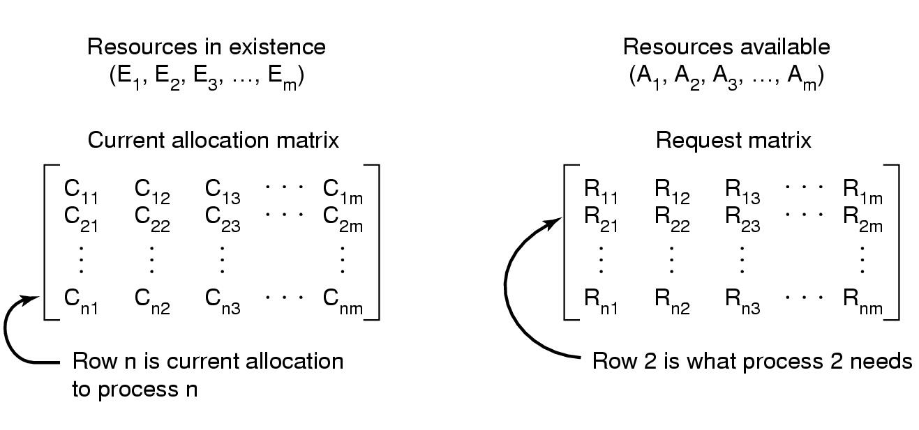
Detection with One Resource of Each Type (2)
Data structures needed by deadlock detection algorithm

Slide 21
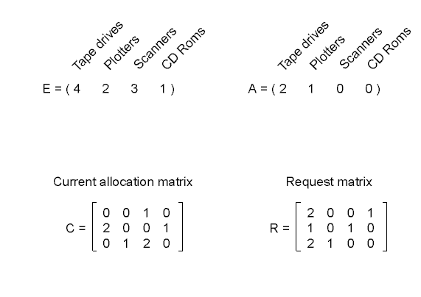
Detection with One Resource of Each Type (3)
An example for the deadlock detection algorithm

Slide 22
Recovery from Deadlock (1)
Recovery through preemption
  take a resource from some other process
  In many cases, manual intervention may be required.
    Esp in Batch Processing Oses running on mainframes
  depends on nature of the resource
  Recovering this way is frequently difficult or impossible
Recovery through rollback
  checkpoint a process periodically
  use this saved state
  restart the process if it is found deadlocked

Slide 23
Recovery from Deadlock (2)
Recovery through killing processes
  crudest but simplest way to break a deadlock
  kill one of the processes in the deadlock cycle
  the other processes get its resources
  choose process that can be rerun from the beginning

Slide 24
Deadlock Avoidance
In deadlock detection, we tacitly assumed that when a process ask for resources, it asks for them all at once.
In most systems, however, resources are requested one at a time.
The system must decide whether granting a resource is safe or not and make allocation only when it is safe

Slide 25
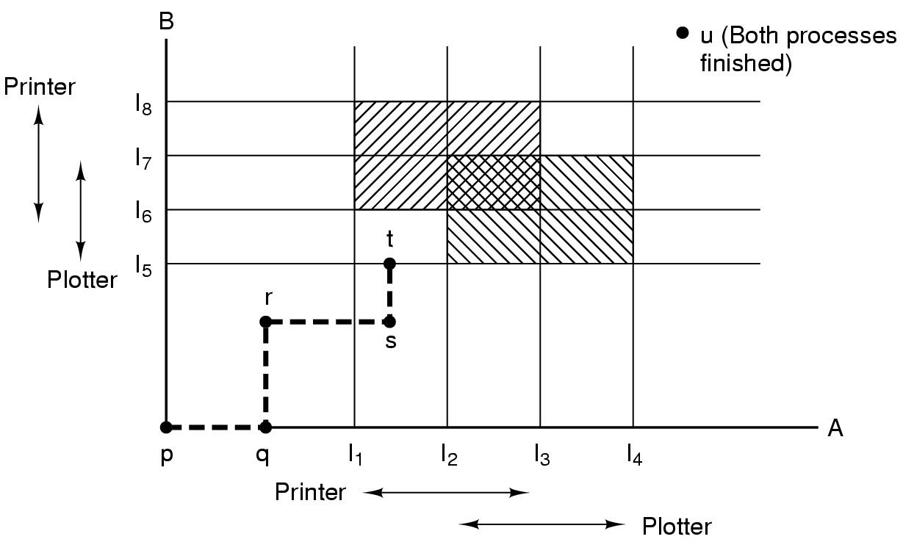
Deadlock Avoidance
Resource Trajectories
Two process resource trajectories

Slide 26
Safe and Unsafe States (1)
Deadlock avoidance algorithms use the information same as deadlock detection for multiple resources.
At any instant of time, there is a current state consisting of E, A, C and R.
A state is said to be safe if it is not deadlocked and there is some scheduling order in which every process can run to completion
  Even if all of them suddenly request their maximum number of resources immediately
It is worth noting that an unsafe state is not a deadlocked state.
The difference between a safe state and an unsafe state is that
  From a safe state, the system can guarantee that all processes will finish.
  From an unsafe state, no such guarantee can be given

Slide 27
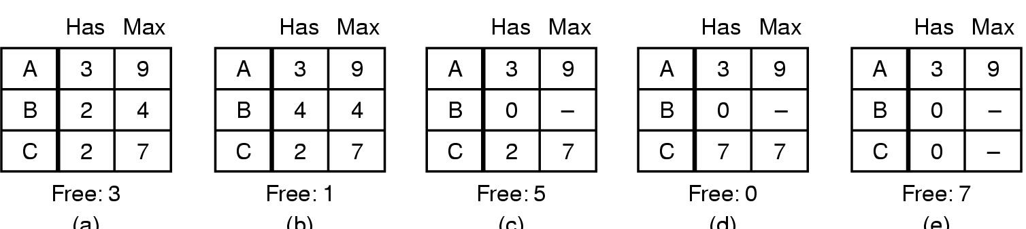
Safe and Unsafe States (1)
(a) (b) (c) (d) (e)
Demonstration that the state in (a) is safe

Slide 28
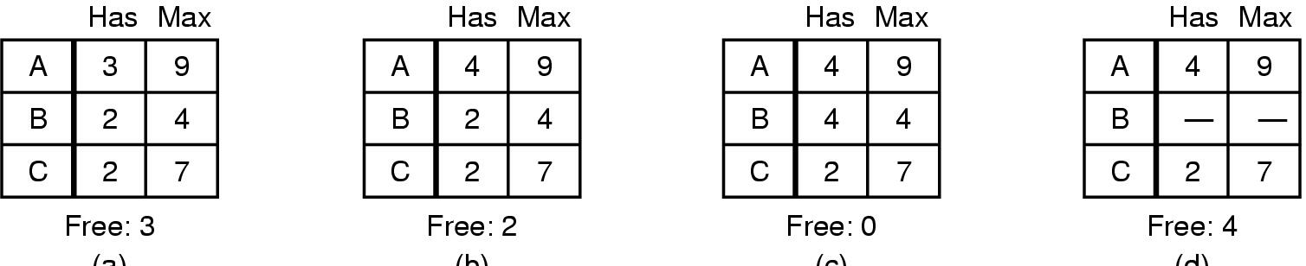
Safe and Unsafe States (2)
(a) (b) (c) (d)
Demonstration that the sate in b is not safe

Slide 29
The Banker's Algorithm for a Single Resource
This algorithm is an extension of the deadlock detection algorithm
It is modeled on the way a small-town banker might deal with a group of customers to whom he has granted lines of credit.
What the algorithm does is
  Check to see if granting the request leads to an unsafe state.
  If it does, the request is denied.
  If it does not, granting the request leads to a safe state.
The banker knows that not all customers will need their maximum credit immediately.
To see if a state is safe, the banker checks to see if he has enough resources to satisfy some customer.
  If so, those loans are assumed to be repaid.
  And the customer now closest to the limit is checked

Slide 30
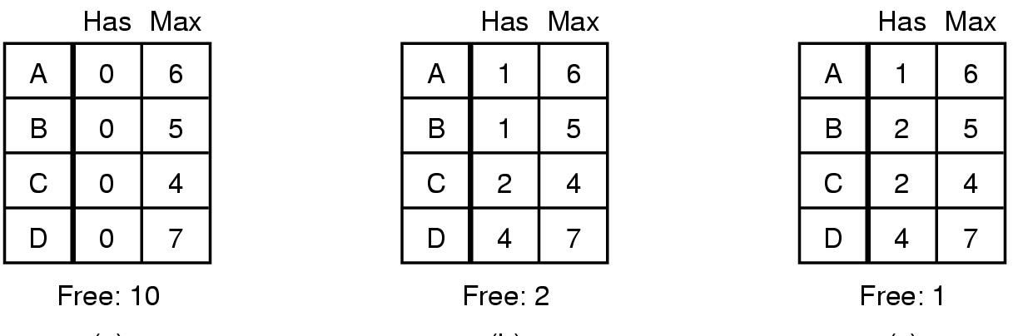
The Banker's Algorithm for a Single Resource
(a) (b) (c)
Three resource allocation states
  safe
  safe
  unsafe

Slide 31
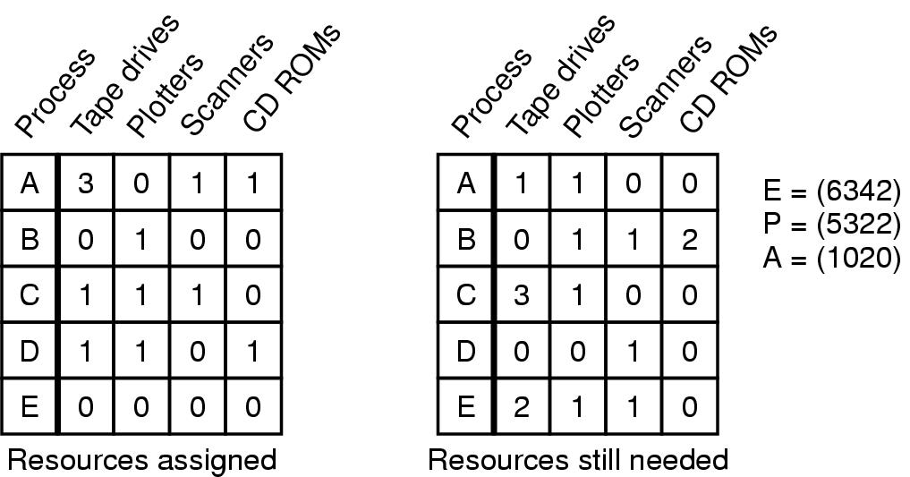
Banker's Algorithm for Multiple Resources
Example of banker's algorithm with multiple resources

Slide 32
Banker's Algorithm for Multiple Resources
Consist of five data structures: two matrixes and three vectors
The first matrix provides information of how many of each resource are currently assigned to each of the processes.
The second matrix provides information of how many resources each process still needs in order to complete.
These matrices are C and R.
Here processes must state their total resource needs before executing, so that the system can compute the R matrix at each instant.
The E vector represents existing resources.
The P vector represents possessed resources.
The A vector represents available resources.
  Is simply the difference between what the system has and what is currently in use

Slide 33
Banker's Algorithm for Multiple Resources
The algorithm for checking to see if a state is safe can now be stated as:
  Look for a row, R, whose unmet resource needs are all smaller than or equal to A
    If no such row exists, the system will eventually deadlock since no process can run to completion.
  Assume the process of the row chosen requests all the resources it needs and finishes.
    Mark that process as terminated and add all its resources to the A vector.
  Repeat steps 1 and 2 until either all processes are marked terminated in which case the initial state was safe or until a deadlock occurs, in which case is unsafe

Slide 34
Problem with Banker’s Algorithm
In practice it is essentially useless because
  Processes rarely know in advance what their maximum resources needs will be
  Also number of processes is not fixed but dynamically varying as new users log in and out.
  Furthermore, resources that were thought to be available can suddenly vanish
    Tape drives can break
    CD Drives make become damaged

Slide 35
Deadlock Prevention
Attacking the Mutual Exclusion Condition
Some devices (such as printer) can be spooled
  only the printer daemon uses printer resource
  thus deadlock for printer eliminated
Not all devices can be spooled
Principle:
  avoid assigning resource when not absolutely necessary
  as few processes as possible actually claim the resource

Slide 36
Attacking the Hold and Wait Condition
Require processes to request resources before starting
  a process never has to wait for what it needs
Problems
  may not know required resources at start of run
  also ties up resources other processes could be using
Variation:
  process must give up all resources
  then request all immediately needed

Slide 37
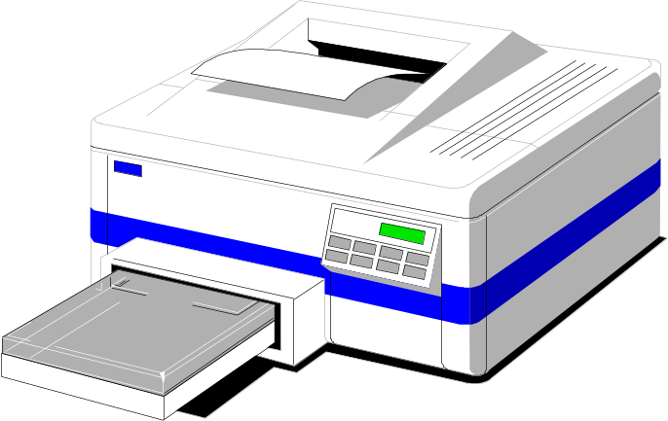
Attacking the No Preemption Condition
This is not a viable option
Consider a process given the printer
  halfway through its job
  now forcibly take away printer
  !!??

Slide 38
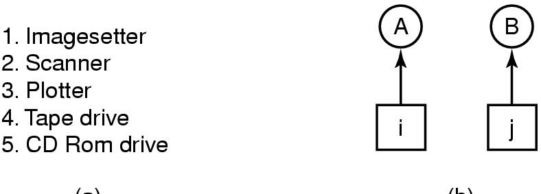
Attacking the Circular Wait Condition (1)
(a) (b)
Normally ordered resources
A resource graph

Slide 39
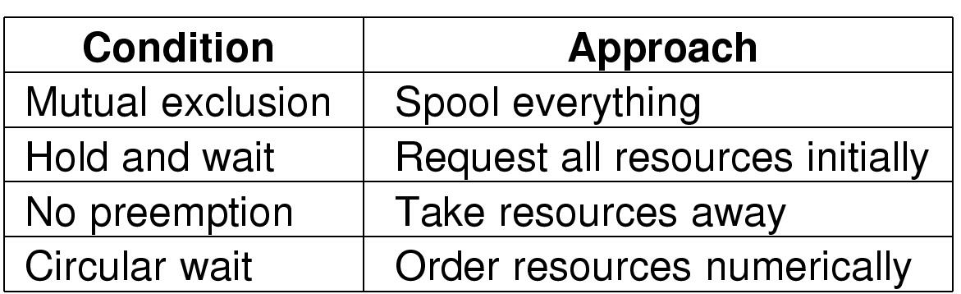
Attacking the Circular Wait Condition (1)
Summary of approaches to deadlock prevention

Slide 40
Other Issues
Two-Phase Locking
Phase One
  process tries to lock all records it needs, one at a time
  if needed record found locked, start over
  (no real work done in phase one)
If phase one succeeds, it starts second phase,
  performing updates
  releasing locks
Note similarity to requesting all resources at once
Algorithm works where programmer can arrange
  program can be stopped, restarted

Slide 41
Nonresource Deadlocks
Possible for two processes to deadlock
  each is waiting for the other to do some task
Can happen with semaphores
  each process required to do a down() on two semaphores (mutex and another)
  if done in wrong order, deadlock results

Slide 42
Starvation
Algorithm to allocate a resource
  may be to give to shortest job first
Works great for multiple short jobs in a system
May cause long job to be postponed indefinitely
  even though not blocked
Solution:
  First-come, first-serve policy

